Slide 1






MACHINE LEARNING PROJECT
CREDIT CARD APPROVAL PREDICTION (CLASSIFICATION PROBLEM AND SUPERVISED ML )
PRESENTED BY HENRY CHAN

Slide 2
Aim and Business Value
Credit card approval process is a common risk control measure in banking industry.
Predict the probability of future defaults of the applicants.
Prediction is based on applicants’ personal information and previous credit record.

Slide 3
Project Flow
Data Cleaning and Exploratory Data Analysis
Cleaning the data and interpreting raw data trend,
1
Machine Learning Model Performance Comparison
Deciding which Machine Learning Model to use.
2
Hypertuning Machine Model
Finding the best parameters for the model.
3

Slide 4
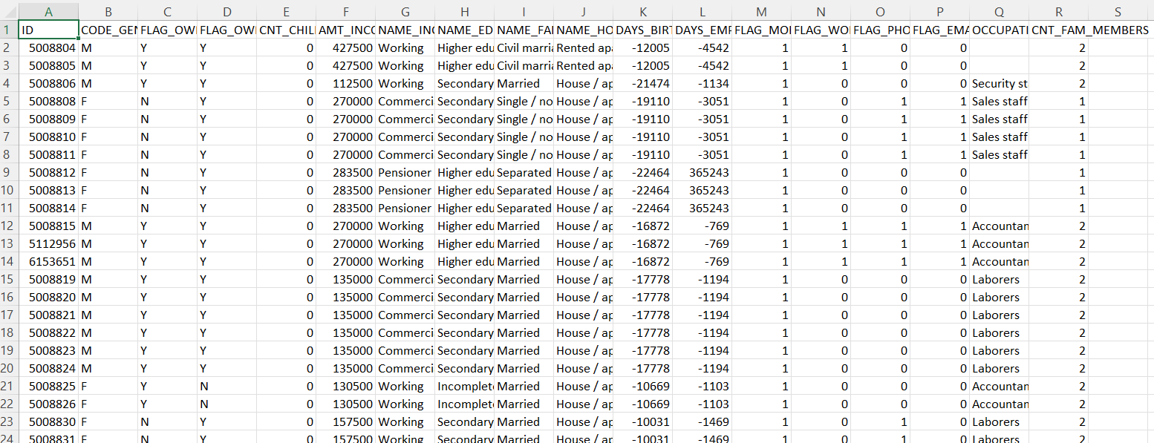
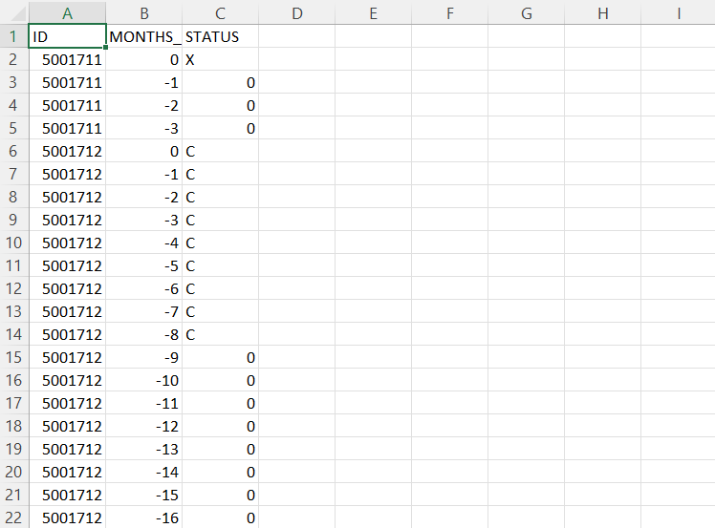
Data Collection
Mock data from the internet
Applicants ’s personal information
Applicant’s previous credit record

Slide 5
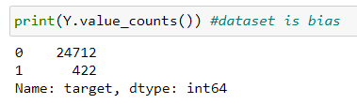
Data Preprocessing
Merging 2 data set together by APPLICATION ID.
Converting binary data and categorical data into the expression of (1,0) by pd.cut, pd.qcut, pd.get_dummies and replace function
Data Featuring - StandardScaler
Using SMOTE to deal with imbalance data set problem. It synthesises new data for minority class based on the existing data.

Slide 6
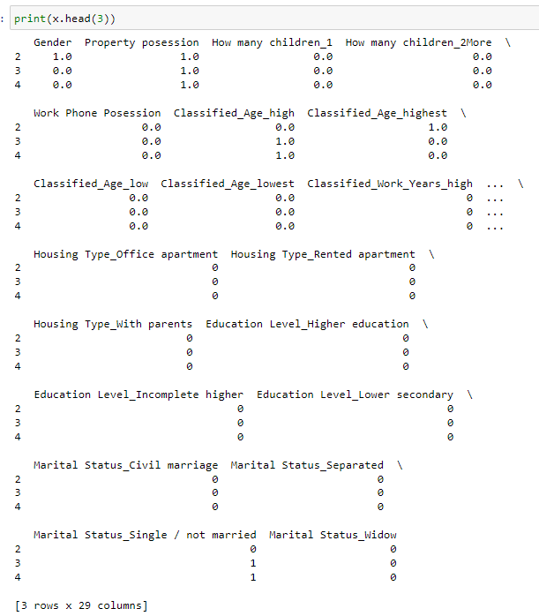
Final DataFrame After Propressing
As long as the applicant had any more than 60 days overdue record in the past, the applicant will be classified as bad applicant.

Slide 7


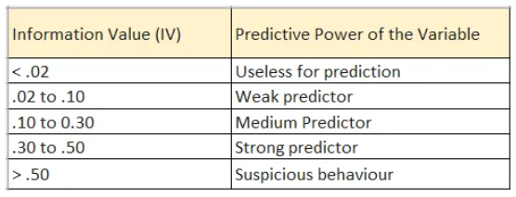
Exploratory Data Analysis
Weight of Evidence
( Finding the distribution of good(event) and bad(non event) in a feature )
Information Value
( Finding the Predictive Power of a feature )

Slide 8
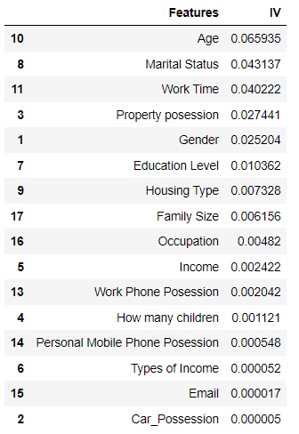
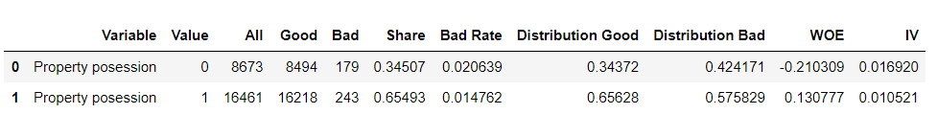
Exploratory Data Analysis
Table of all IV
*Finding WoE and IV for each feature

Slide 9
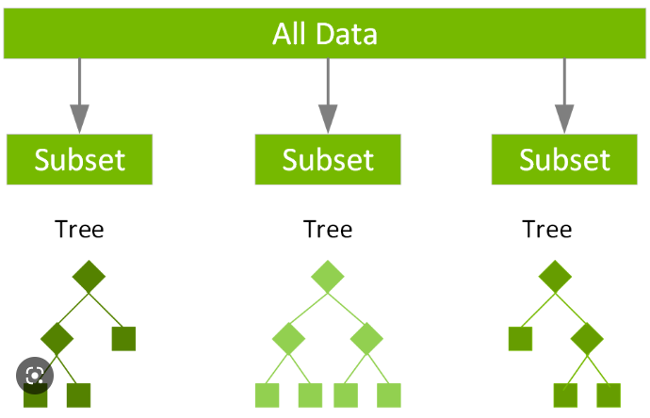
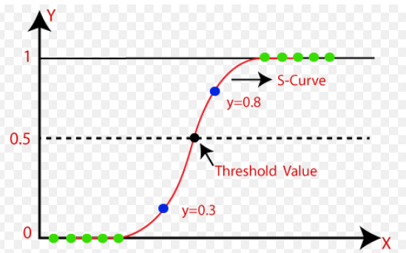
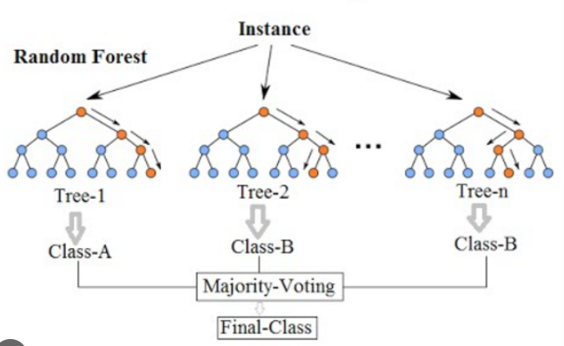
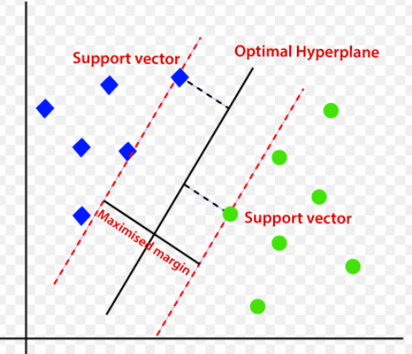
Machine Learning Algorithms
XGBoost
Logistic Regression
XGB
LR
Random Forest
Support Vector Classification
RF
SVC

Slide 10
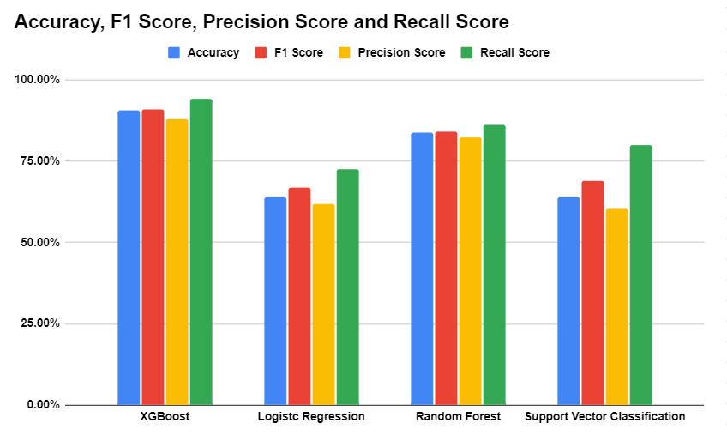
Machine Learning Performance Comparison

Slide 11

XGBoost Hyperparameter Tuning
By GridSearch CV
n_estimators - Number of tree to be generated. The larger it is, the more complex is the model.
colsample_bytree - Subsample ratio for each tree when the trees are constructed.
gamma - Specifying the minimum lost reduction required to make a split. The larger the gamma is, the more conservative the model is.
learning_rate - Controlling the step size in the direction of negative gradient. The smaller it is, the more complex is the model.
max_depth - Determining how specific the model to learn the relations of the data set. The larger max_depth, the easier to over-fit.
min_child_weight - Minimum sum of instance weight needed in a child. The larger it is, the more conservative the model is.
reg_alpha - L1 regularization on leaf weights. The larger it is , the more conservative the model is.
reg_lambda - L2 regularization on leaf weights. The larger it is, the more conservative the model is.

Slide 12



XGBoost Hyperparameter Tuning
Performance Comparison
Accuracy increases 0.735%

Slide 13
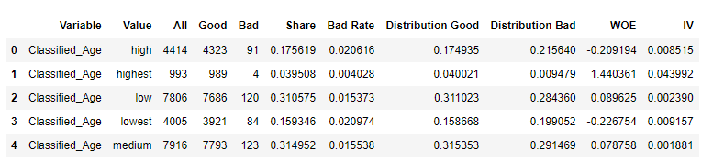
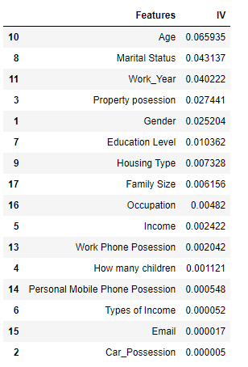
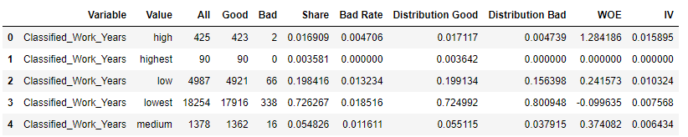
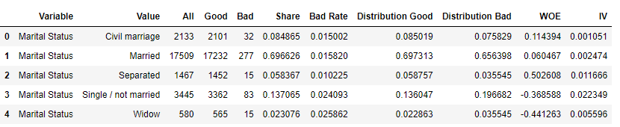
Insight Analysis
Table of all IV
📌
📌
📌

Slide 14
Insight Analysis
The younger the applicants are
The more likely they become bad customers
Marital Status : Widow
More likely to become bad customers

Slide 15
Limitation and Next Steps
Imbalance Data
Include more bad applicants data
Ideally 50% : 50%

Slide 16

Conclusion
By using Machine Learning we can swiftly and accurately predict the credit payment overdue probability of applicants with more than 90% accuracy!

Slide 17
Thank you

